Slide 1
Multiplexing Techniques

Slide 2
Session Objectives
Introduction
    Multiplexing
    Categories of multiplexing
Frequency-division multiplexing (FDM)
    Multiplexing process
    De-multiplexing process
    Examples
Wavelength division multiplexing (WDM)
Time-division multiplexing (TDM)
    Synchronous TDM
    Time slots and frames
    Interleaving
    Empty slots
    Data rate management: multilevel, multiple-slot, and pulse stuffing
Notes:
1.#

Slide 3
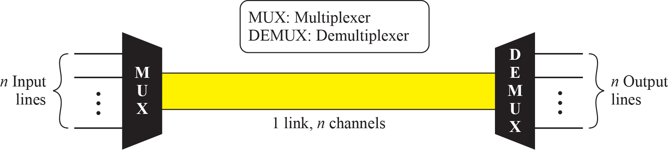
MULTIPLEXING
Multiplexing is the set of techniques that allows simultaneous transmission of multiple signals across a single data link.
As data and telecommunications use increases, so does traffic.
We can accommodate this increase by continuing to add individual links each time a new channel as needed, or we can install higher-bandwidth links and use each to carry multiple signals.
Figure-1 : Dividing a link into channels
Notes:
1.#

Slide 4

Categories of Multiplexing
Notes:
6.#

Slide 5
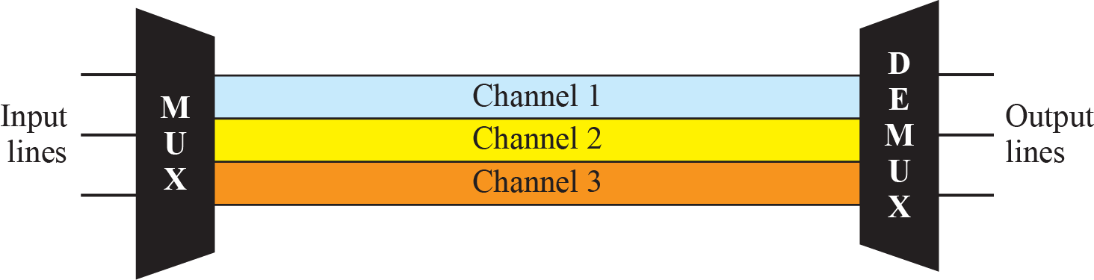
Frequency-Division Multiplexing
Frequency-division multiplexing (FDM) is an analog technique that can be applied when the bandwidth of a link (in hertz) is greater than the combined bandwidths of the signals to be transmitted.
In FDM, signals generated by each sending device modulate different carrier frequencies.
These modulated signals are then combined into a single composite signal that can be transported by the link.
Notes:
1.#

Slide 6

Multiplexing Process
Notes:
6.#

Slide 7

De-multiplexing Process
Notes:
6.#

Slide 8
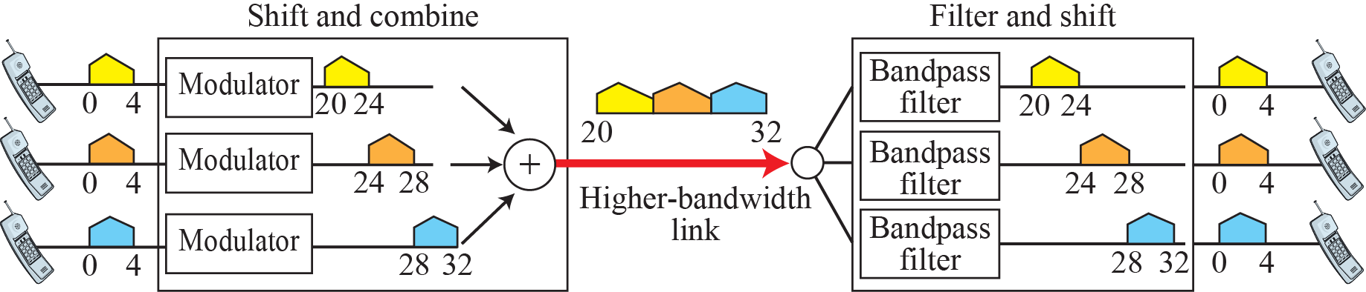
Example 1
Assume that a voice channel occupies a bandwidth of 4 kHz. We need to combine three voice channels into a link with a bandwidth of 12 kHz, from 20 to 32 kHz. Show the configuration, using the frequency domain. Assume there are no guard bands.
Solution
Shift (modulate) each of the three voice channels to a different bandwidth, as shown in below.

Slide 9

Example 2
Five channels, each with a 100-kHz bandwidth, are to be multiplexed together. What is the minimum bandwidth of the link if there is a need for a guard band of 10 kHz between the channels to prevent interference?
Solution
For five channels, we need at least four guard bands. This means that the required bandwidth is at least 5 × 100 + 4 × 10 = 540 kHz, as shown in Figure.

Slide 10
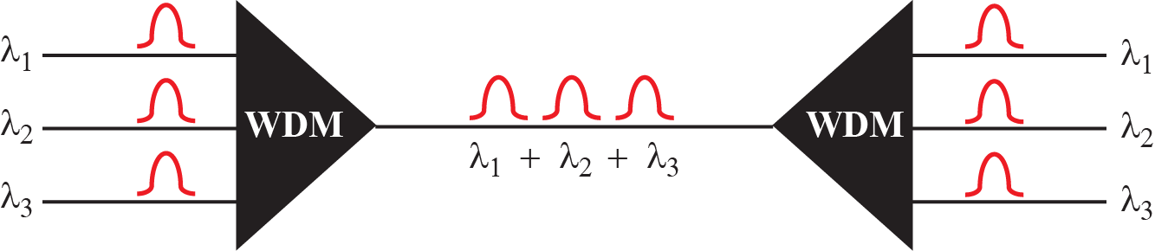

Wavelength-Division Multiplexing
Wavelength-division multiplexing (WDM) is designed to use the high-data-rate capability of fiber-optic cable.
The optical fiber data rate is higher than the data rate of metallic transmission cable, but using a fiber-optic cable for a single line wastes the available bandwidth.
Multiplexing allows us to combine several lines into one.
Wavelength-division multiplexing
Prisms in wave-length division multiplexing
Notes:
1.#

Slide 11
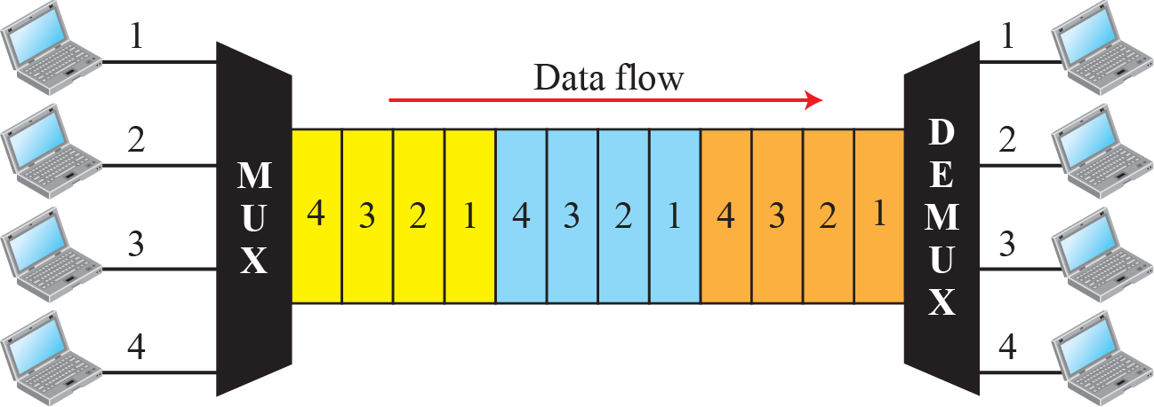
Time-Division Multiplexing
Time-division multiplexing (TDM) is a digital process that allows several connections to share the high bandwidth of a link.
Instead of sharing a portion of the bandwidth as in FDM, time is shared.
Each connection occupies a portion of time in the link.
Note that the same link is used as in FDM; here, however, the link is shown sectioned by time rather than by frequency.
In the figure, portions of signals 1, 2, 3, and 4 occupy the link sequentially.
Notes:
1.#

Slide 12
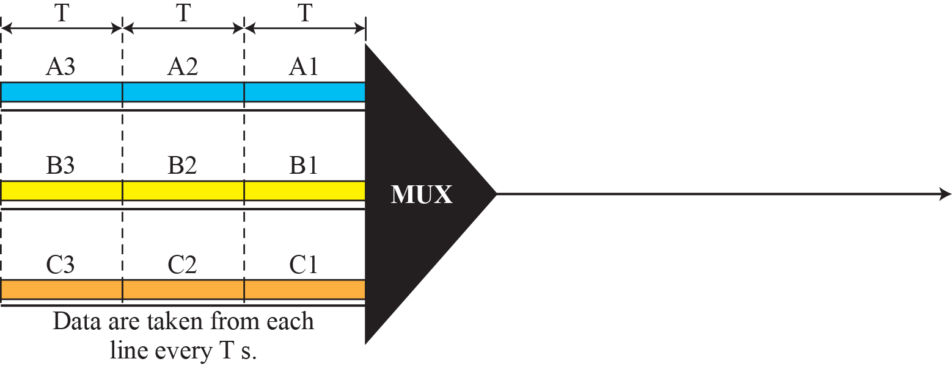
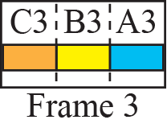
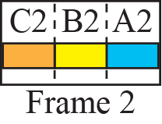
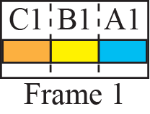
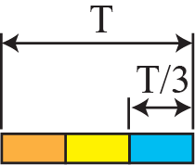

Synchronous Time-Division Multiplexing: Time slots and frames
In Synchronous TDM, the data rate of the link is n times faster, and unit duration is n time shorter
Notes:
6.#

Slide 13
Example 3
In above figure, the data rate for each input connection is 1 kbps. If 1 bit at a time is multiplexed (a unit is 1 bit), what is the duration of
1. each input slot,
2. each output slot, and
3. each frame?
Solution
1. The data rate of each input connection is 1 kbps. This means that the bit duration is 1/1000 s or 1 ms. The duration of the input time slot is 1 ms (same as bit duration).
2. The duration of each output time slot is one-third of the input time slot. This means that the duration of the output time slot is 1/3 ms.
3. Each frame carries three output time slots. So the duration of a frame is 3 × (1/3) ms, or 1 ms. The duration of a frame is the same as the duration of an input unit.

Slide 14

INTERLEAVING
Notes:
6.#

Slide 15
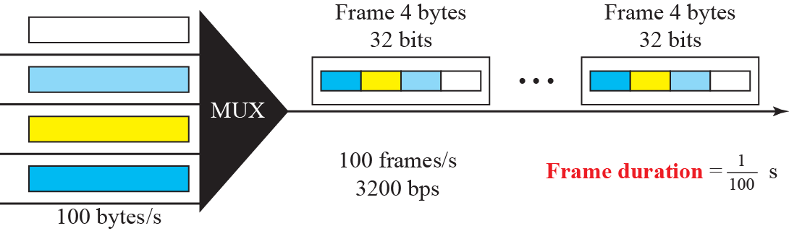
Example 4
Four channels are multiplexed using TDM. If each channel sends 100 bytes/s and we multiplex 1 byte per channel, show the frame traveling on the link, the size of the frame, the duration of a frame, the frame rate, and the bit rate for the link.
Solution
The multiplexer is shown in Figure. Each frame carries 1 byte from each channel; the size of each frame, therefore, is 4 bytes, or 32 bits.
The frame rate is 100 frames per second. [100 * 8=800 bits/s; 800 * 4 =3200 bits/s; 3200/32=100 frame/sec]
The duration of a frame is therefore 1/100 s.
The link is carrying 100 frames per second, and since each frame contains 32 bits, the bit rate is 100 × 32, or 3200 bps.

Slide 16
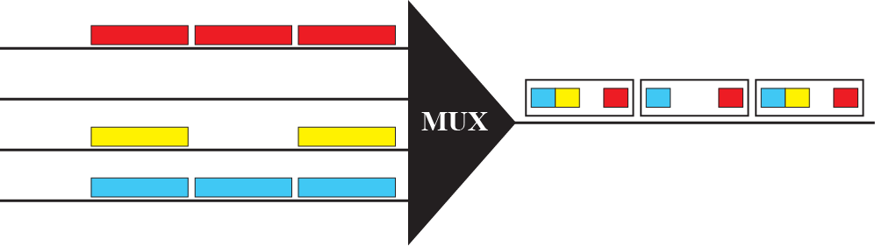
Empty Slots
Notes:
6.#

Slide 17
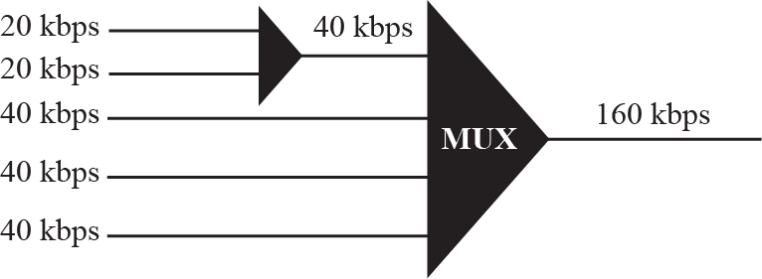
Multilevel Multiplexing
Notes:
6.#

Slide 18
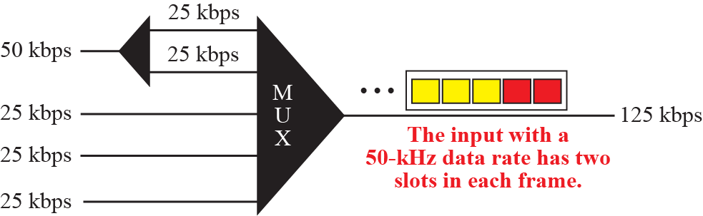
Multiple-slot Multiplexing
Notes:
6.#

Slide 19
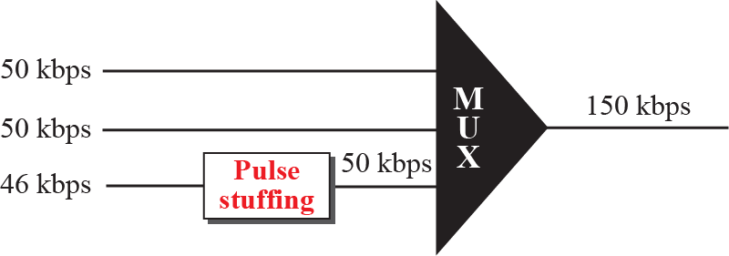
Pulse stuffing
Notes:
6.#

Slide 20
Summary
In this section we have discussed the following:
Multiplexing concept
Multiplexing techniques as TDM, FDM and WDM.
Interleaving and bit stuffing
Notes:
1.#

Slide 21

Notes:
1.#

